Slide 1
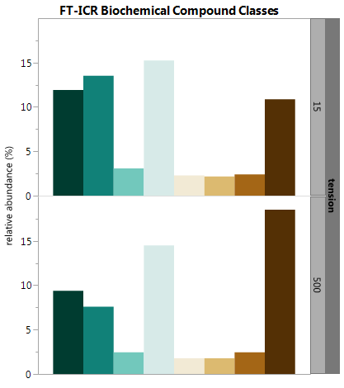
Coarse Pores
Fine Pores
Core 32

